Slide 1
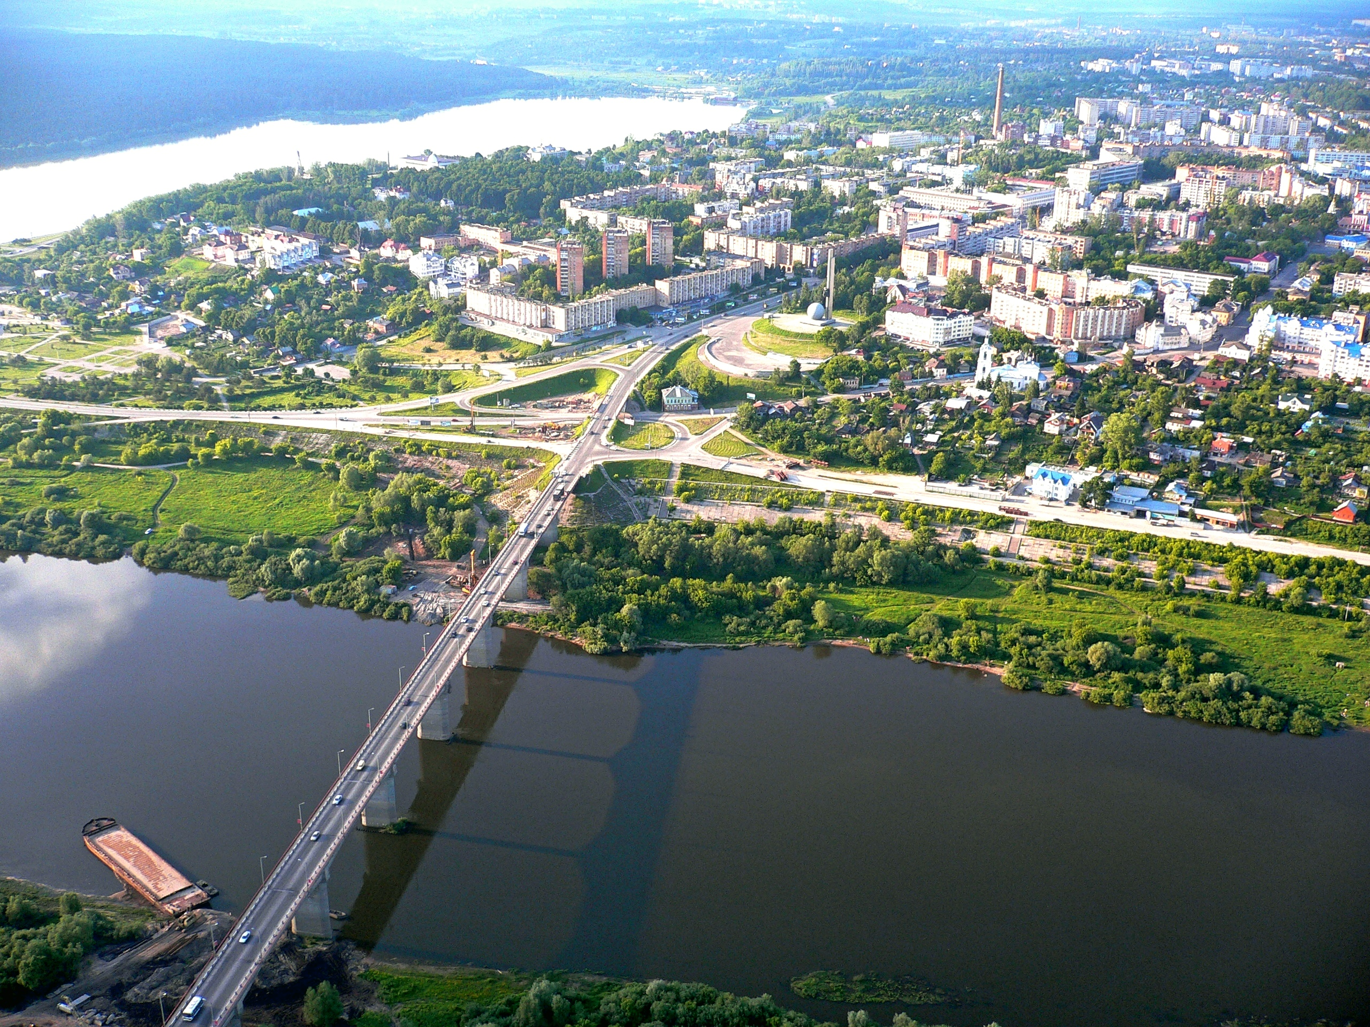
Annual distribution of the Oka River flow in Kaluga under the conditions of climate change
Marina Zakharova, PhD
Kaluga State University after named K.E. Tsiolkovski, Russia
Abstract
Methods and Materials
This work is devoted to the study of the features of annual distribution of the Oka river flow in the hydrological station of Kaluga in the modern period.
As the result, the values of annual seasonal flow with a probability of exceeding 95% were established. The seasonal distribution of low-water group of water bearing of river was done.
There was a redistribution of river flow between the months and seasons of the year.
The real year method is used to calculate the annual flow distribution based on hydrological observations for the period 1987-2017.
This method is in selecting from a few years the such year, which is the closest to the probability of exceedance for the year and for the limiting period (seasons) both.
The part of year from June to February is taken for the limiting period, the periods from June to August and from December to February – for the limiting season, i.e. low-water periods.
The probability of exceedance is set at 95% according to the drinking water supply type.
Fig. 1. Estimated distribution of the flow by month of 2015-2016 year.
Table 1. Parameters of the probability distribution curves of flow.
Results
Statistical parameters | Year | Limiting period | Limiting season
 |  |  | Summer-Winter | Summer-Autumn
Cv | 0.24 | 0.21 | 0.23 | 0.26
Cs | 0.38 | 0.74 | 0.84 | 1.02
Cs/Cv | 1.59 | 3.55 | 3.61 | 3.95
σCv | 0.02 | 0.02 | 0.02 | 0.04
σCs | 0.39 | 0.43 | 0.43 | 0.46
The parameters of probability distribution curves for the series of modular coefficients for the specified periods are determined by the maximum likelihood method (Table 1).
The relative mean square error of the average long-term runoff value for all series is less than 5%, the relative mean square error of the coefficient of variation is within 10-15%.
Thus, the absolute values of flow of 95% probability of exceedance is 2227 m³∙s⁻¹ for the year, is 1216 m³∙s⁻¹ for the limiting period and is 835 m³∙s⁻¹ for the limiting season. Flow of the third (spring) season (or non-limiting period), which is not included in the limiting period, is 1011 m³∙s⁻¹. Flow for the non-limiting season, which is included in the limiting period, is 382 m³∙s⁻¹.
Accordingly, the relative values of flow of 95% probability of exceedance increase to 54.6% of the annual one in the limiting period and they reduce to 45.4% in the non-limiting period for the low-water years. Besides the flow of probability of exceedance of 95% is 37.5% of the annual flow in spring and winter seasons. Such redistribution of the river flow is in the low-water years.
The seasonal distribution of runoff is calculated for a low-water group of years by the real year method. It is found that the real year is 2015-2016.
Figure 1 shows the results of the monthly and the seasonal distribution of flow for the low-water year by the chosen actual one.
Conclusions
Analysis of the season distribution of flow showed that 19.9% of the spring flow is in March, 6.9% of the summer flow is in June. The distribution of flow from July to November is almost unchanged and varies from 6.1% in July to 5.5% in November, the most value of the winter flow is 9.4% in December.
In general, the relative distribution of the spring flow is 41.4%, of the summer-autumn is 35.7%, of the winter flow is 22.9%. Such distribution of runoff into the summer-autumn and winter periods indicates about sustainability of underground food.
These results prove the features of distribution of the annual flow of the Oka River basin, which are related to a decrease in the unevenness of distribution of the annual flow and an increase of the ratio of the low-water flow, especially in the winter.
This circumstance should be considered when planning the use of water for various water management needs.
Introduction
As is well known, the main element of renewable water resources is the river flow.
The study of annual distribution of the river flow in the recent period is explained by the need to adapt a complex water management system to seasonal changes of flow under the conditions of climate change.
Information about an annual flow distribution is important for planning water supply to urban populations in order to provide environmental safety in changing climatic conditions.
For instance, water supply in Kaluga and the Kaluga region is provided from underground and surface sources, but it is known that 50% of the total amount is the surface water intakes.
Contact
Marina Zakharova
Kaluga State University after named K.E. Tsiolkovski, Russia
Email: maryno4ka80@gmail.com
Website: https://tksu.ru/

